Slide 1

Christopher B. Barrett
Charles H. Dyson School of Applied Economics & Management
Cornell University
J.W. Lecture at the University of Georgia
November 19, 2015
Development Resilience:
Theory, Measurement
& Implications

Slide 2

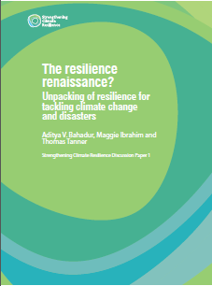



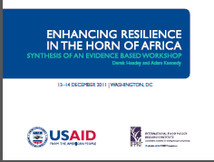
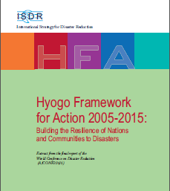


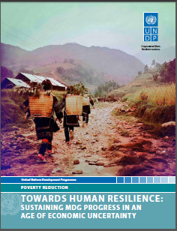

Motivation
“Resilience” has rapidly become a ubiquitous buzzword, but ill-defined concept within the development and humanitarian communities

Slide 3
Motivation
Why development and humanitarian communities’ current fascination with “resilience”?
Risk perceived increasing in both frequency and intensity
Recurring crises lay bare the longstanding difficulty of reconciling humanitarian response to disasters with longer-term development efforts.
Increasingly recognize interdependence of biophysical and socioeconomic systems. Tap ecological work on resilience.
Need a theory-measurement-and-evidence-based understanding of what resilience is with respect to human well-being, how to measure it, and how to effectively promote it so as to sustainably reduce chronic poverty/food insecurity.

Slide 4
Motivation
At the same time, much ambivalence (even cynicism) about the ‘rise of resilience’
Seen as too imprecise and malleable a concept/term
As commonly formulated, not pro-poor
Too often ignores issues of agency/power/rights
Barrett & Constas (PNAS 2014) advances a theory of resilience to address some of these concerns: development resilience.

Slide 5
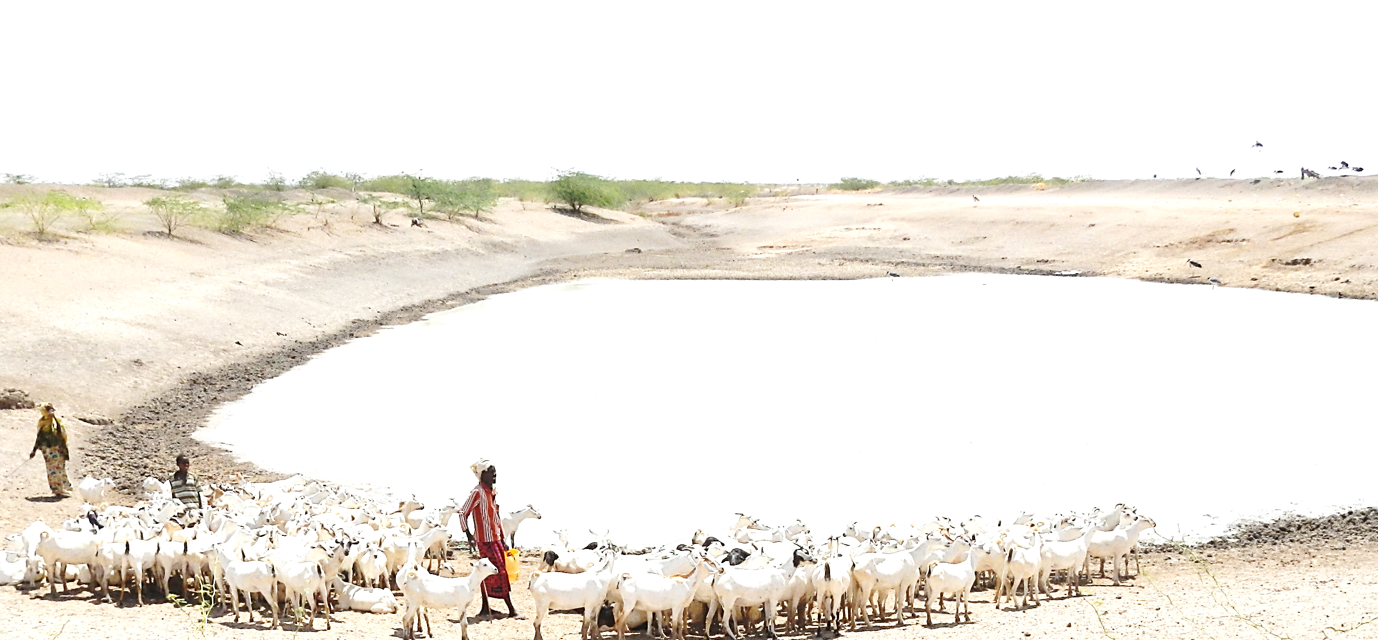
Motivation
Resilience of What? A Parable

Slide 6
Toward a Theory
Resilience of whom to what?
Subject of interest: quality of life, ~ Sen’s ‘capabilities’.
Focus further on minimizing the human experience of chronic poverty.
This implies:
focus on individuals’ (and groups’) well-being within a system, not the state of a system itself. Explicitly normative.
do not focus on specific sources of risk b/c problem is uninsured exposure to many stressors (ex ante risk) and shocks (ex post, adverse realizations) to which resilience implies adaptability while staying/becoming non-poor.

Slide 7
Toward a Theory
Concept of Development Resilience (B&C 2014):
Development resilience is the capacity over time of a person, household or other aggregate unit to avoid poverty in the face of various stressors and in the wake of myriad shocks. If and only if that capacity is and remains high, then the unit is resilient.
Key Elements: stochastic dynamics of (aggregable) individual standards of living
Normative implication: prioritize avoidance of and escape from chronic poverty and minimize within the population and over time the experience of low standards of living.

Slide 8
Toward a Theory
Stochastic Well-Being Dynamics
Consider the moment function for conditional well-being:
m^{k}(W_{t+s} | W_{t}, ε_{t})
where m^{k} represents the k^{th} moment (e.g., mean (k=1), variance (k =2), skewness (k =3), etc.
W_{t} is well-being at the beginning of period t
ε_{t} is an exogenous disturbance (scalar or vector) during period t
These moment functions describe quite generally, albeit in reduced form, the stochastic conditional dynamics of well-being.

Slide 9
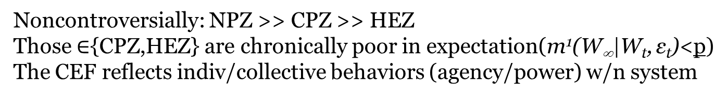
Toward a Theory
Ex: Expected well-being dynamics with multiple stable states (m¹(W_{t+s} | W_{t}, ε_{t}) ) and thresholds T1,T2
Noncontroversially: NPZ >> CPZ >> HEZ
Those $∈${CPZ,HEZ} are chronically poor in expectation(m¹(W∞|W_{t}, ε_{t})<p)
The CEF reflects indiv/collective behaviors (agency/power) w/n system

Slide 10
Toward a Theory
The development ambition is to move people into the non-poor zone and keep them there.
The humanitarian ambition is to keep people from falling into HEZ … offers a foundation for a rights-based approach to resilience.
For the current non-poor, seek resilience/resistance against shocks in the ecological sense: no shift to either of the lower, less desirable zones.
But for the current poor, those in HEZ/CPZ, the objective is productive disruption, to shift states to the NPZ.
Asymmetry is therefore a fundamental property of resilience against chronic poverty. Thus stability ≠ resilience.

Slide 11
Toward a Theory
Explicitly incorporate risk by integrating multiple moment functions to move from CEF to CTDs:
Note: Transitory shocks (- or +) can have persistent effects
Risk endogenous to system state
CTDs reflect both natural and socioeconomic contexts

Slide 12
Toward Systems Integration
Feedback between sub-systems can be crucial
Generalize to admit the role of the natural resource state, R_{t}:
m^{k}(W_{t+s} | W_{t}, R_{t}, ε_{t})
And recognize that parallel dynamics exist for the resource:
rm^{k}(R_{t+s} | R_{t},W_{t}, ε_{t})
Now feedback potentially arises between R and W
(e.g., range conditions depend on herd size/stocking rate, disease reproduction depends on household incomes)
Or at least correlation due to ε_{t} (e.g., climate).
Then the resilience of the underlying resource base becomes instrumentally important to resilience against chronic poverty.

Slide 13
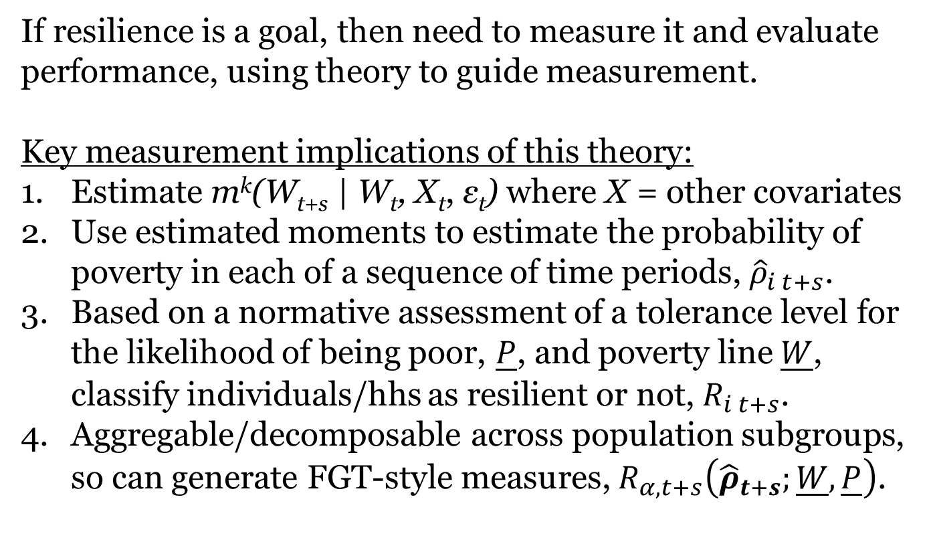
Toward Measurement and Evaluation
If resilience is a goal, then need to measure it and evaluate performance, using theory to guide measurement.
Key measurement implications of this theory:
Estimate m^{k}(W_{t+s} | W_{t}, X_{t}, ε_{t}) where X = other covariates
Use estimated moments to estimate the probability of poverty in each of a sequence of time periods, ${\hat{ρ}}_{i t+s}$.
Based on a normative assessment of a tolerance level for the likelihood of being poor, $\underline{P}$, and poverty line$\underline{W}$, classify individuals/hhs as resilient or not, $R_{i t+s}$.
Aggregable/decomposable across population subgroups, so can generate FGT-style measures, $R_{α, t+s}\left({\hat{ρ}}_{t+s};\underline{W},\underline{P}\right)$.
(Cissé & Barrett 2015)

Slide 14
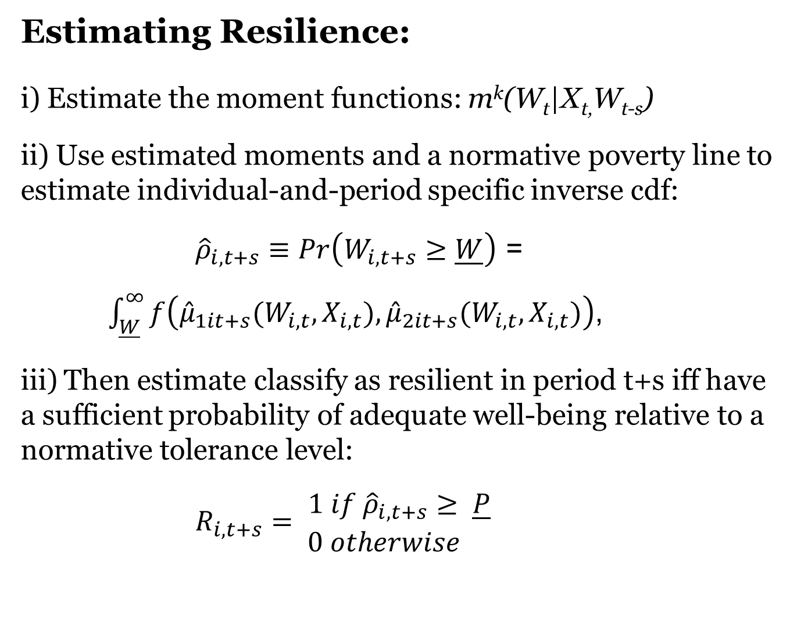
Estimating Resilience
Estimating Resilience:
i) Estimate the moment functions: m^{k}(W_{t}|X_{t,}W_{t-s})
ii) Use estimated moments and a normative poverty line to estimate individual-and-period specific inverse cdf:
${\hat{ρ}}_{i,t+s}≡Pr\left(W_{i,t+s}≥\underline{W}\right)$ =
$\int_{\underline{W}}^{∞}{f\left({\hat{μ}}_{1it+s}(W_{i,t},X_{i,t}),{\hat{μ}}_{2it+s}(W_{i,t},X_{i,t})\right)}$,
iii) Then estimate classify as resilient in period t+s iff have a sufficient probability of adequate well-being relative to a normative tolerance level:
$R_{i,t+s}= \begin{matrix}1 if {\hat{ρ}}_{i,t+s}≥ \underline{P} \\ 0 otherwise \end{matrix}$

Slide 15
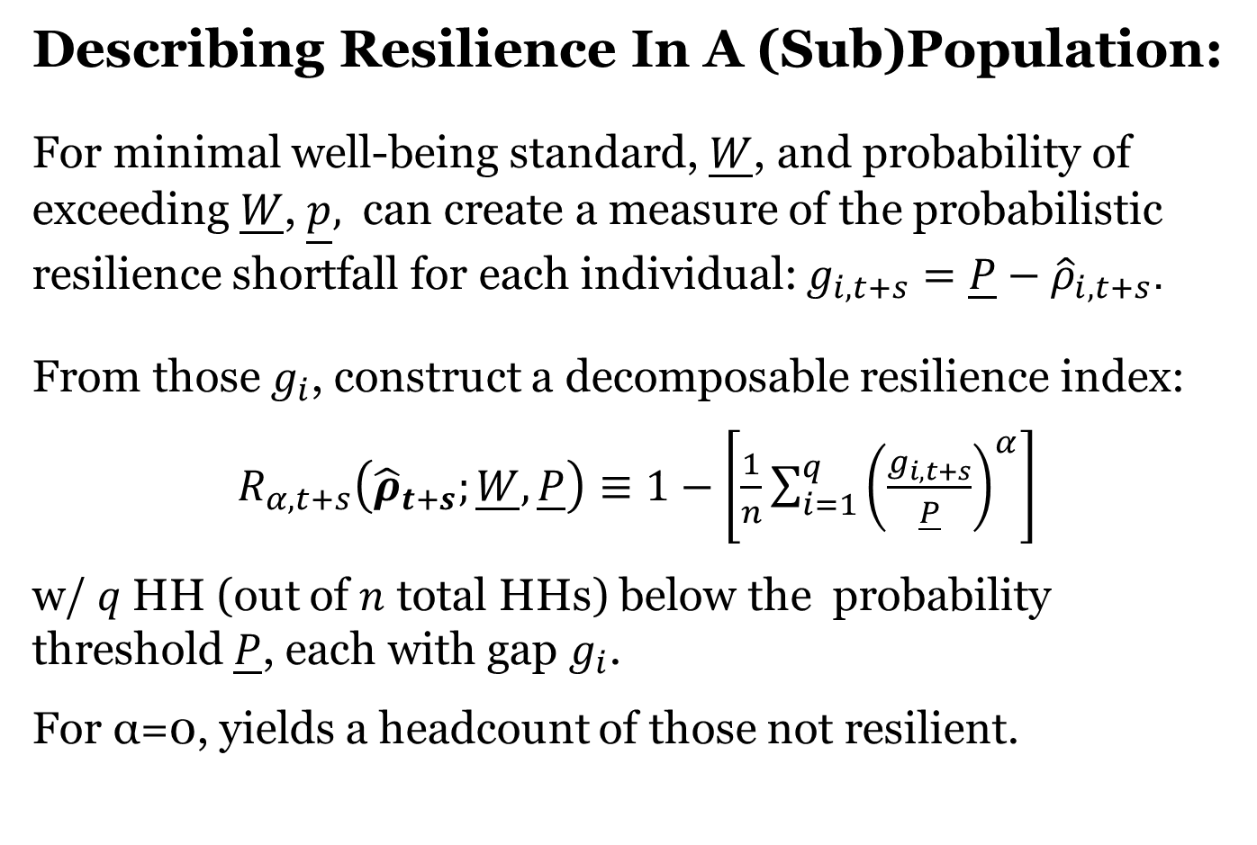
Describing Resilience
Describing Resilience In A (Sub)Population:
For minimal well-being standard, $\underline{W}$, and probability of exceeding $\underline{W}$, $\underline{p},$ can create a measure of the probabilistic resilience shortfall for each individual: $g_{i,t+s}=\underline{P}−{\hat{ρ}}_{i,t+s}$.
From those $g_{i}$, construct a decomposable resilience index:
$R_{α, t+s}\left({\hat{ρ}}_{t+s};\underline{W},\underline{P}\right)≡1−\left[\frac{1}{n}\sum_{i=1}^{q}{{\left(\frac{g_{i,t+s}}{\underline{P}}\right)}^{α}}\right]$
w/ $q$HH (out of $n$ total HHs) below the probability threshold $\underline{P}$, each with gap $g_{i}$.
For α=0, yields a headcount of those not resilient.

Slide 16
Programming implications
Objective: minimize the duration, intensity and likelihood of people’s experience of poverty
Three options:
Shift people’s current state – i.e., increase W_{t}. Ex: transfers of cash, education, land or other assets.

Slide 17
Programming implications
Objective: minimize the duration, intensity and likelihood of people’s experience of poverty
Three options:
2) Alter CTDs directly – i.e., use risk reduction (e.g., breeding, policing) or risk transfer (e.g., insurance, EGS, CCTs) to truncate ε_{t} .

Slide 18
Programming implications
Objective: minimize the duration, intensity and likelihood of people’s experience of poverty
Three options:
3) Change underlying system structure -Shift m^{k}(.) – technology/ institutions – induces ∆ in behaviors and CTDs. Challenge: multi-scalar reinforcement – ‘fractal poverty traps’ (Barrett and Swallow 2006 WD)

Slide 19
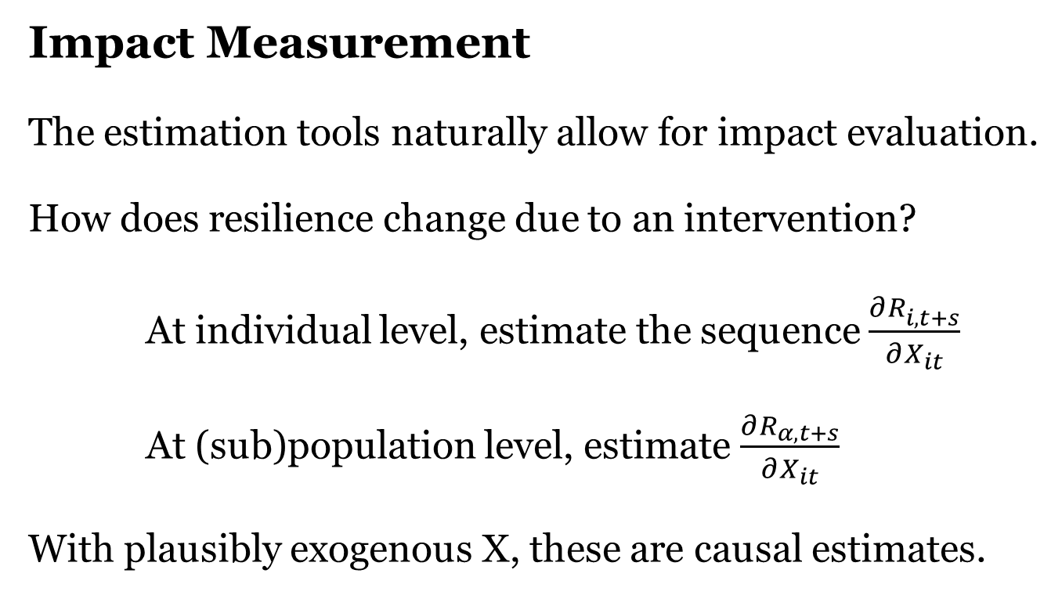
Impact Evaluation
Impact Measurement
The estimation tools naturally allow for impact evaluation.
How does resilience change due to an intervention?
At individual level, estimate the sequence $\frac{∂R_{i,t+s}^{}}{∂X_{it}}$
At (sub)population level, estimate $\frac{∂R_{α, t+s}}{∂X_{it}}$
With plausibly exogenous X, these are causal estimates.

Slide 20
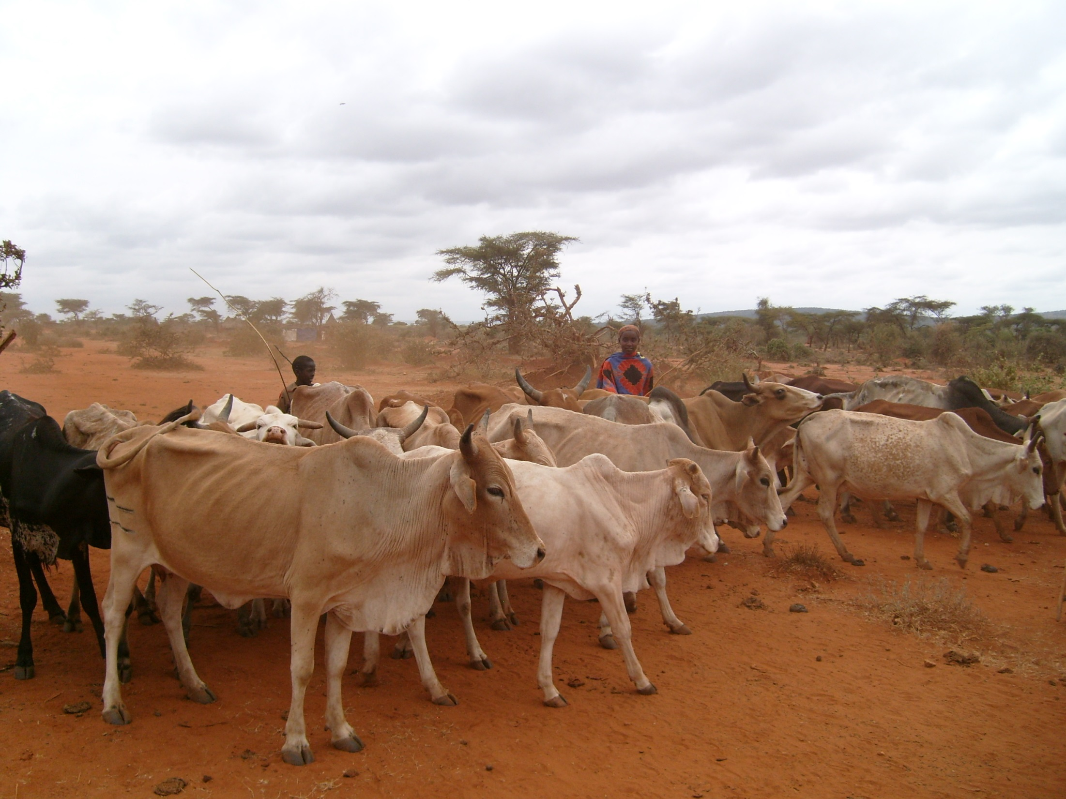
Empirical Illustration
Setting: Arid/semi-arid lands of northern Kenya (Marsabit). Introduced livestock insurance in 2010. Major drought in 2011.
Data: Annual household surveys, 2009-2013 (n=924 hh)

Slide 21
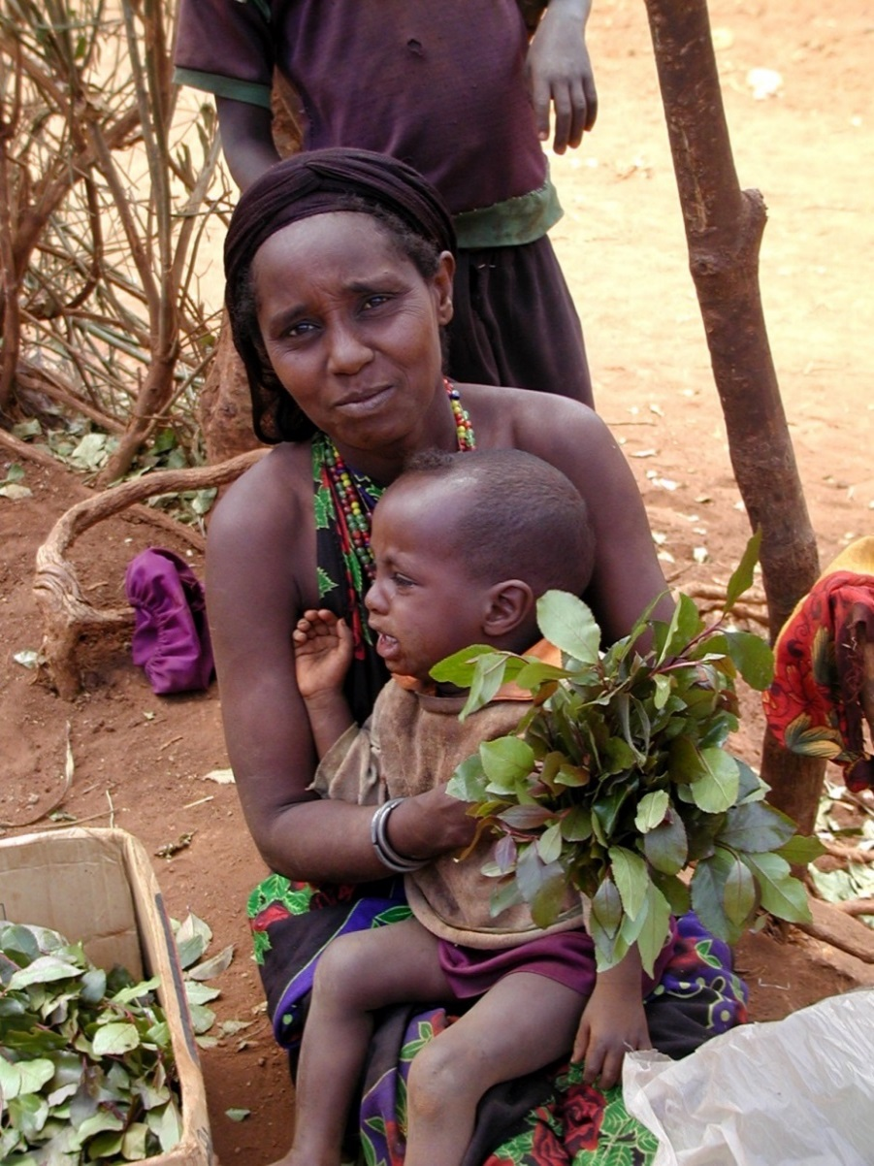
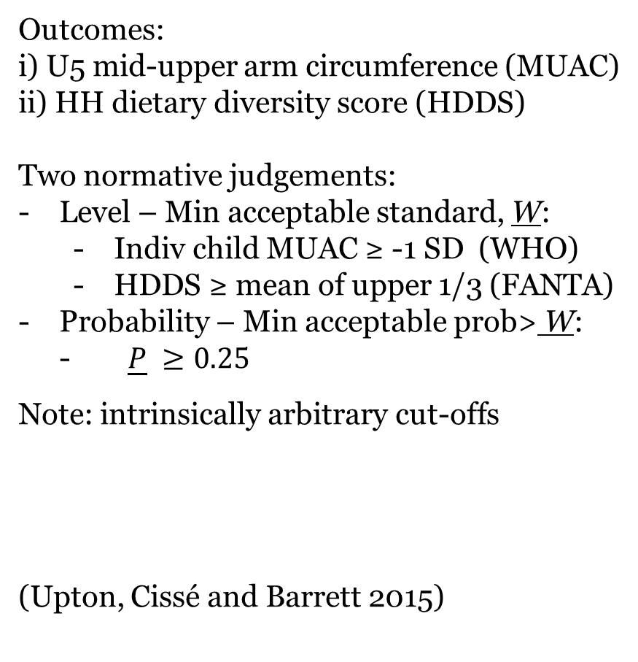
Empirical Illustration
Choose an outcome variable(s) and threshold(s):
  Outcomes:
  i) U5 mid-upper arm circumference (MUAC)
  ii) HH dietary diversity score (HDDS)
  Two normative judgements:
  Level – Min acceptable standard, W:
    Indiv child MUAC ≥ -1 SD (WHO)
    HDDS ≥ mean of upper 1/3 (FANTA)
  Probability – Min acceptable prob> W:
  - $\underline{P} ≥0.25$
Note: intrinsically arbitrary cut-offs
  (Upton, Cissé and Barrett 2015)

Slide 22
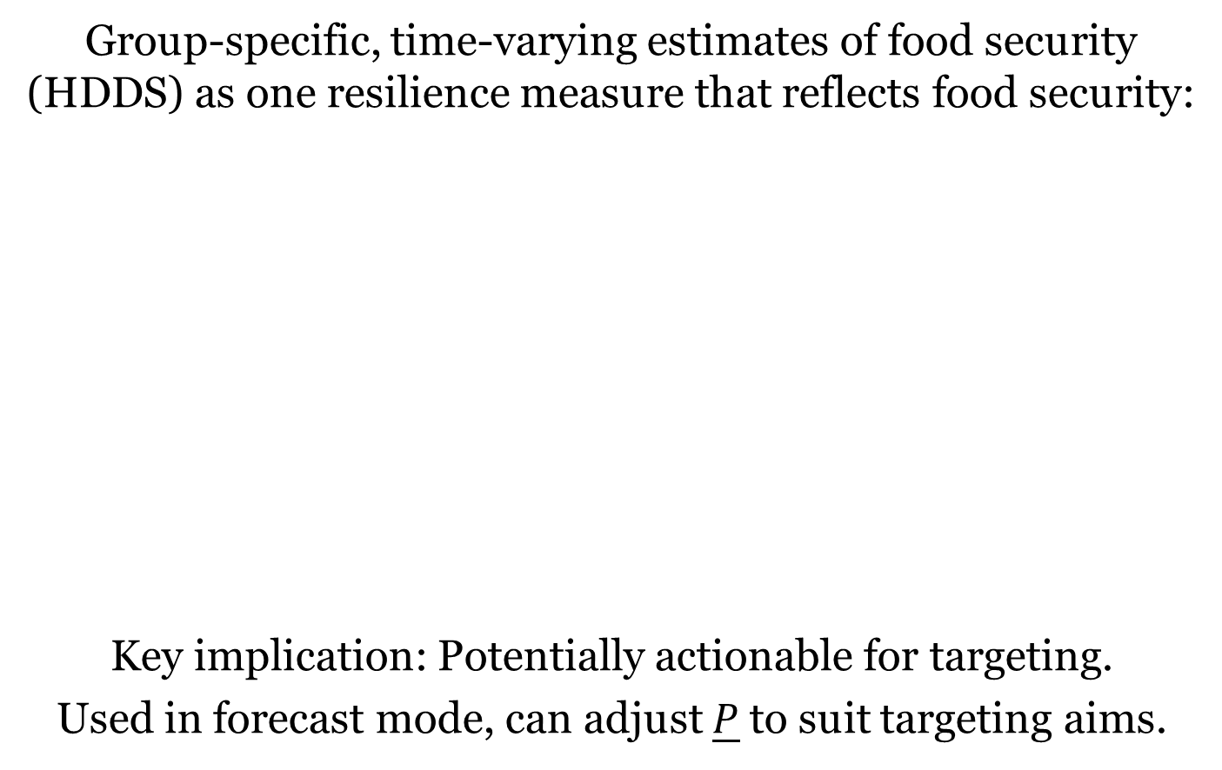
Illustration:
Targeting
Group-specific, time-varying estimates of food security (HDDS) as one resilience measure that reflects food security:
Key implication: Potentially actionable for targeting.
Used in forecast mode, can adjust $\underline{P}$to suit targeting aims.

Slide 23
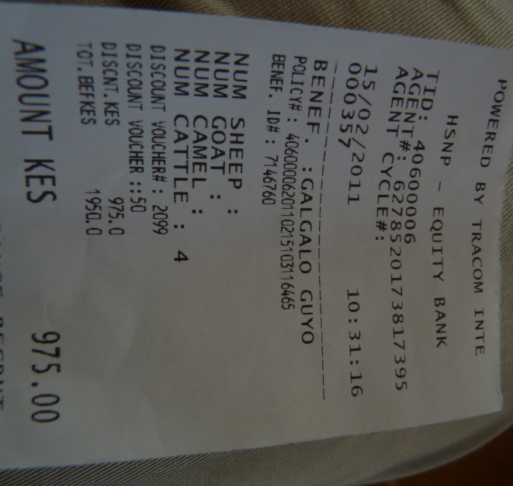
Illustration:
Impact evaluation
What effects of drought or insurance on resilience?
  Causal effect on resilience (MUAC), based on RCT:
  Major drought: -0.109***
  (0.019)
  Insurance: 0.080***
  (0.023)
  Major drought (herd losses>15%) has an adverse effect on children’s resilience reflected in MUAC.
  But livestock insurance largely offsets those adverse effects.

Slide 24
Data demands
Taking resilience seriously will require significant investments in high-frequency longitudinal data
Proposed sentinel sites (Barrett Science 2010, Headey & Barrett PNAS 2015)

Slide 25
Summary
Resilience is a popular buzzword now. But too little precision in its use, theoretically, methodologically or empirically.
Rigorous use of the concept can help identify how best to avoid and escape chronic poverty/malnutrition.
Requires advances in theory, systems integration, empirical measurement in many different contexts and over time.
Implies a massive, interdisciplinary research agenda, especially as agencies begin using resilience as a programming principle.
But we must start with a firm theoretical foundation and derivative measurement and evaluation methods.

Slide 26
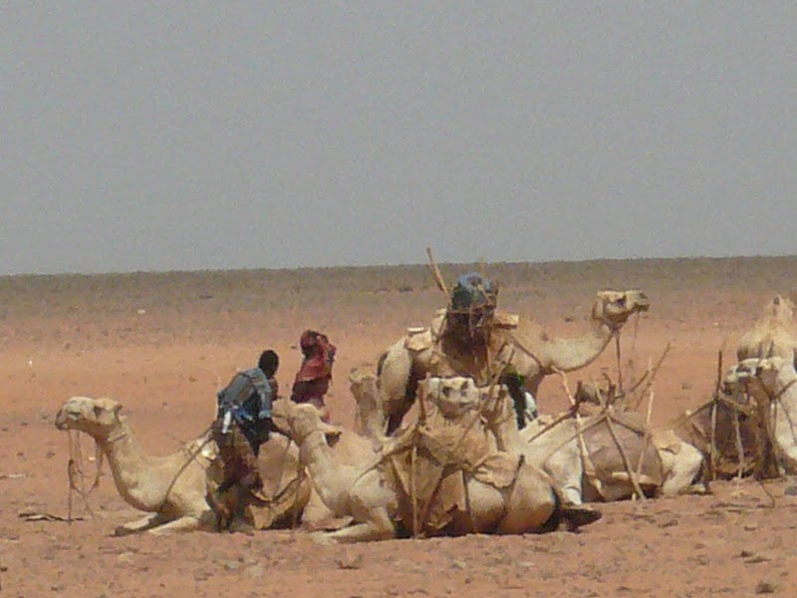
Thank you
Thank you for your time, interest and comments!

